Slide 1
2020-21 Benefit Information/Changes

Slide 2
Notes:
Aspiration #2 – Courageous Influence

Slide 3
2020-21 Benefit Plan Options
Medical Insurance – Carrier Change
Dental Insurance – Benefit Enhancement – Adding MAXAdvantage
Vision Insurance – Renewing with EyeMed
Health Savings Account (HSA) – Vendor Change
Flexible Spending Account (FSA): Medical and Dependent Care
Basic Life and AD&D: District Paid
Voluntary Life and AD&D: Employee, Spouse, Children
Disability: Short Term and Long Term
Voluntary Critical Illness: With or Without Cancer
Voluntary Accident Insurance
Permanent Life with Long Term Care
Identity Theft
Voluntary Hospital Indemnity
New Plan 7/1/20!

Slide 4
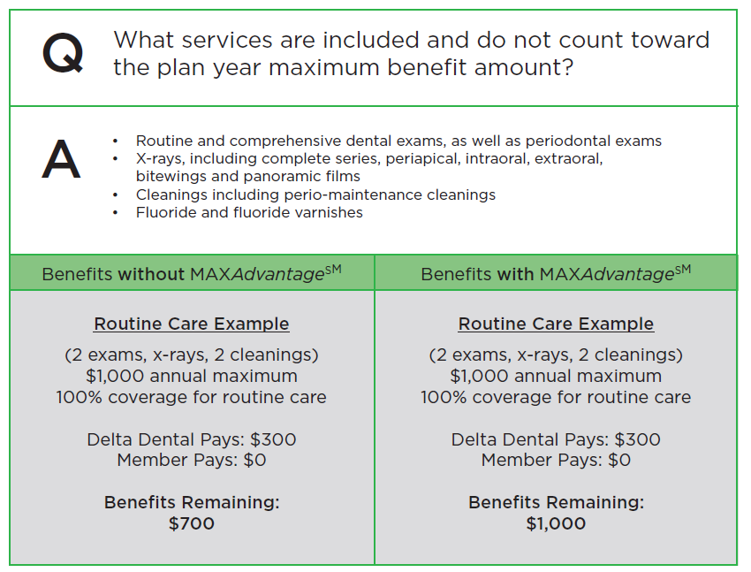
DENTAL PLAN ENHANCEMENT – Delta Dental of MO MAXAdvantage Benefit Option
No change to dental networks, premiums or plan designs with Delta Dental of Missouri
The dental plan will continue to pay up to $1,000 per covered person, per calendar year for non-orthodontic health services.
Beginning 7/1/20, preventive services do not apply to this $1,000 maximum benefit amount.

Slide 5
VOLUNTARY VISION PLAN - EyeMed
No change to plan designs or network
Rates are increasing, but are still the most competitive available in the market with the district’s generous plan design
Coverage for anti-reflective coating and progressive lenses
Monthly Premium | EyeMed - Current | EyeMed - Renewal
Employee | $8.54 | $9.66
Employee + Spouse | $17.00 | $19.22
Employee + Child(ren) | $18.18 | $20.54
Family | $29.04 | $32.82

Slide 6
VOLUNTARY HOSPITAL INDEMNITY PLAN - Guardian
New Plan 7/1/20!
Cash Benefit upon Hospitalization
Benefits Include:
No Pre-Existing Condition Limitation
Payable to you
No health questions required to enroll
Hospital/ICU Admission: $1k / $2k per admission
Hospital/ICU Confinement: $200/$400 per day, up to 15 days per benefit year
Limit to 1 per insured, or 3 admissions per covered family per benefit year
Health Screening: $50 per insured per benefit year

Slide 7
Net Claims Trend
Claims performance vs contract
Medical / rx Carrier change reminders
Search for network providers with Aetna at www.aetna.com/docfind:
Click on “Find a Doctor”
Under “Guests”, choose “Plan from an employer”
Enter your City and State, and modify the search radius (up to 100 miles)
Under “Select A Plan, scroll down to the section entitled “Kansas & Missouri Preferred Networks (includes HealthFund Plans)”, and choose the appropriate plan as follows
To search for HDHP providers, scroll down and select “I-35 Preferred - PPO”
To search for EPO plan providers in the I-35 preferred network HNO plan within the KC metro area, scroll down to choose “I-35 Preferred Aetna Select (Open Access) and Health Network Only”
Call the Aetna Concierge team for assistance locating providers outside of the Kansas City area

Slide 8
Net Claims Trend
Claims performance vs contract
Medical / rx Carrier change reminders
Confirm your current prescriptions are available through the Aetna formulary
Visit www.aetna.com/formulary
Scroll down, to the “Choose your plan:” section
Select “2020” under “Choose a Plan Year”
Select “Advanced Control Plan-Aetna” under “Choose a Plan”
Be sure to refill any and all prescriptions prior to 6/30/2020 under the BlueKC health plan
Provide your Aetna ID card for any medical services received, or prescription fills on and after July 1, 2020

Slide 9
Net Claims Trend
Claims performance vs contract
Transition of care
Transition of Care may be available to assist with:
Continued treatment plans that you are on with your provider and that provider is not in the proposed Aetna network
EX: Chemotherapy, Pregnancy, Surgery follow-up
If you think you may need to ask for a Transition of Care benefit consideration, please contact Misty Miller, Benefits Specialist, misty.miller@nkcschools.org.

Slide 10
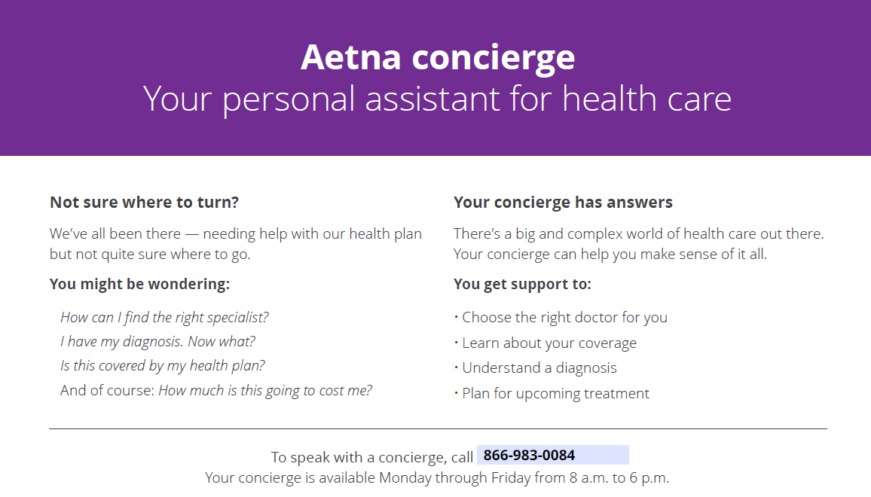
Net Claims Trend
Claims performance vs contract
CONCIERGE SERVICES

Slide 11
Net Claims Trend
Claims performance vs contract
METRO HOSPITAL NETWORK COMPARISON
Kansas City Metro Hospital Listing
Hospital Name | Current Network BlueSelect Plus | Proposed Network Aetna I-35
Advent Health (Shawnee Mission Medical Center) | X | X
Center Point Medical Center | NO | NO
Children’s Mercy Hospitals | X | X
KU Medical Center | X | X
Lee’s Summit Hospital | NO | NO
Liberty Hospital | X | X
Menorah Medical Center | NO | NO
North Kansas City Hospital | X | X
Olathe Medical Center | X | X
Overland Park Regional | NO | NO
Providence Medical Center | NO | NO
Research Medical Center | NO | NO
St. Joseph Medical Center | NO | NO
St. Luke’s (All Locations) | NO | NO
St. Mary’s Medical Center | NO | NO
Truman Medical Center (Hospital Hill & Lee’s Summit) | X | X

Slide 12
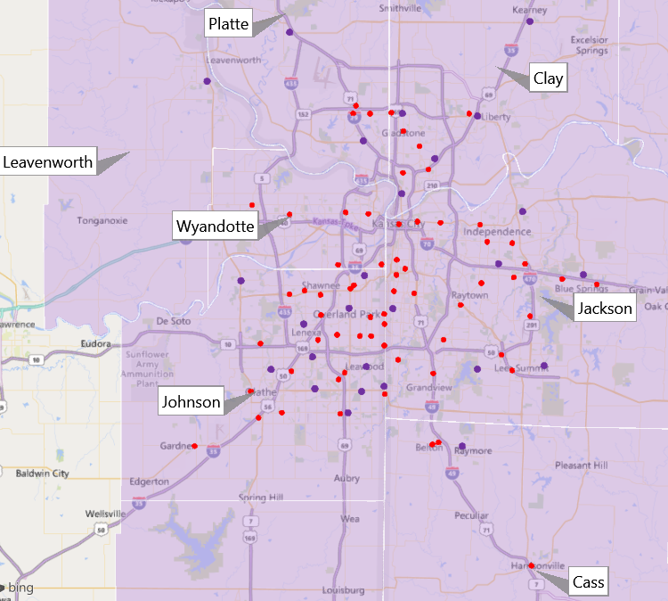
CVS Retail Footprint in Kansas City
92 CVS Pharmacies 
27 Minute Clinics 
Note:
Pharmacies are inclusive of Target stores
3 Health Hubs opening in the Northland in 2020
Opening March 2020:
19th & Swift
13 in the KC Metro by 2021
Source CVS data
Notes:
No x-ray capabilities @ Health Hubs or Minute Clinics
Navigator available to help with questions, and finding appropriate items within CVS (DME)

Slide 13
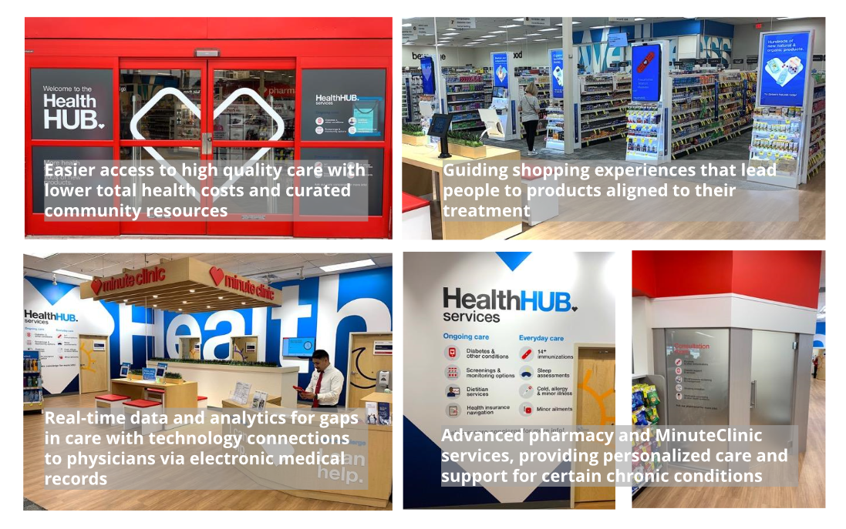
HealthHUB locations reimagine the traditional healthcare experience
Kansas City Metro will help lead the way with 13 HealthHUB’s scheduled to open in 2020.
First location: 19th & Swift.

Slide 14
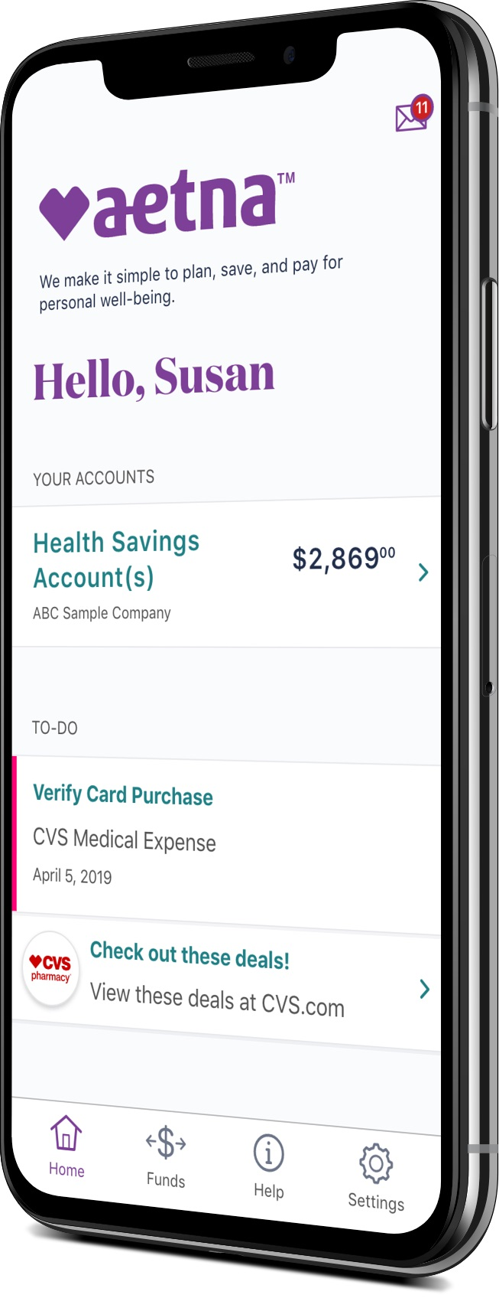
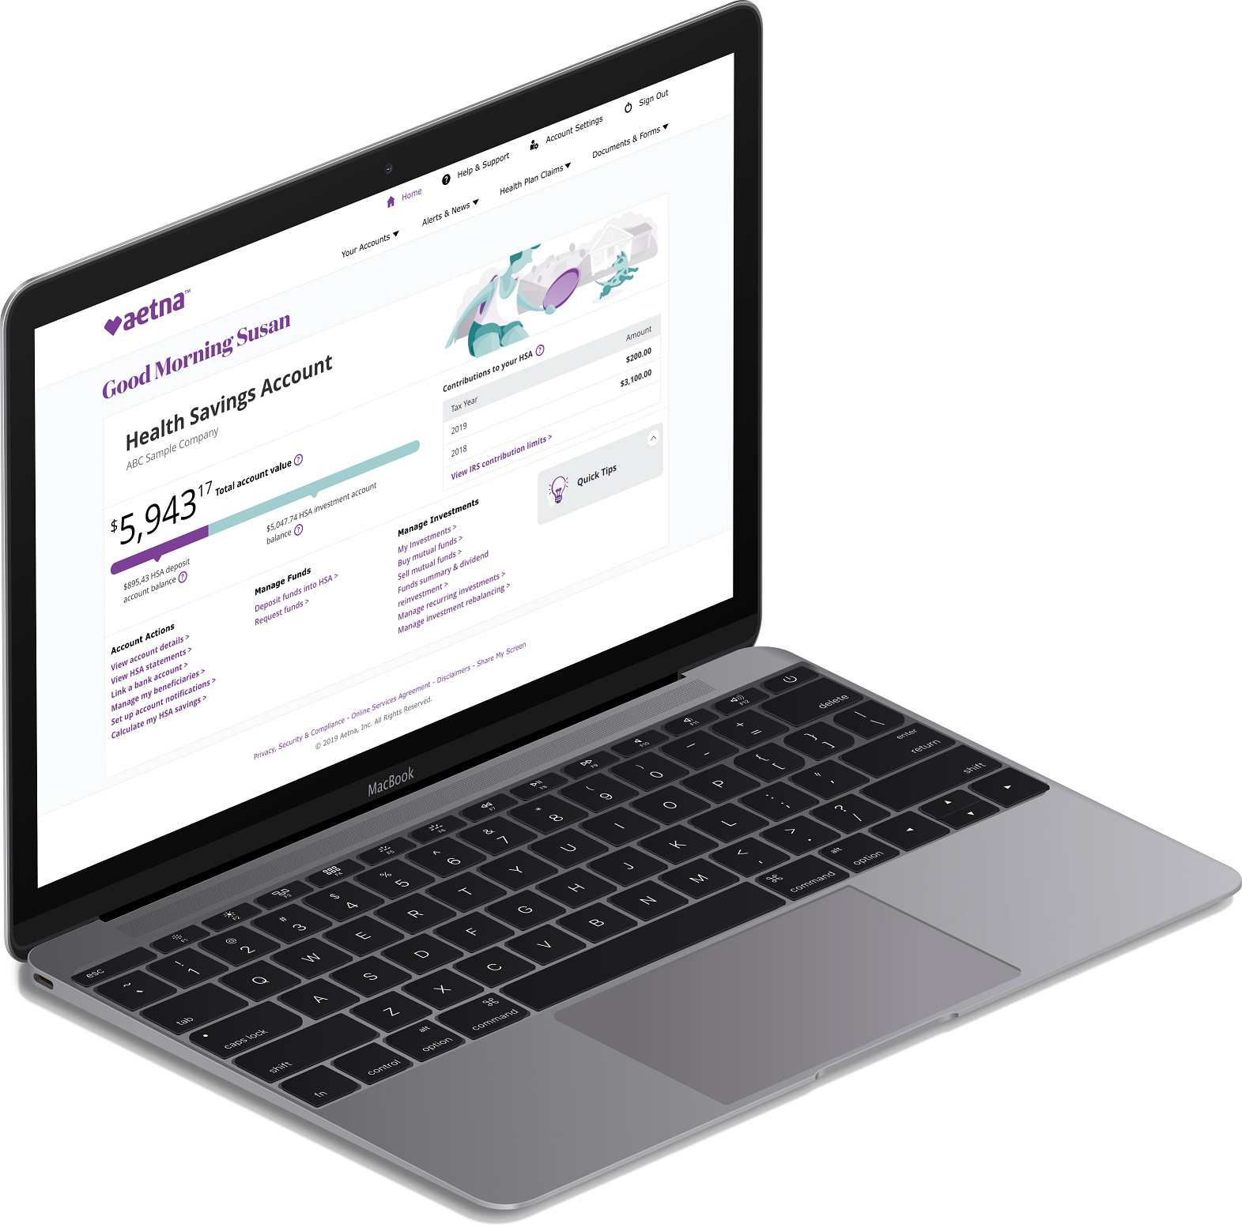
Put the Power of Integration in Your Corner
Tax-advantaged Health Savings Accounts
Consumer engagement expertise
Data insights
Use cases
Clinical impact
Helping educate on the value of health care dollars while anticipating health care costs
Enhanced navigation and unified look and feel will allow a member to feel like financial accounts are part of their health and well being experience
A fully integrated health plan and health care spending account program for our members.

Slide 15
MEDICAL PLAN OVERVIEW –
A1 EPO Copays ($$$)
Network | I-35 Preferred Aetna Select & Elect Choice
Deductible
In-network (indiv/family) | $0
Out-of-network (indiv/family) | N/A
Coinsurance | 100%
Medical Out-of-Pocket*
In-network (indiv/family) | $3,500/$7,000
Out-of-network (indiv/family) | N/A
Inpatient Hospital Copay | $500 per admit
Office Visit Copay (PCM/Specialist/Meritas) | $40/$80/$0
Urgent Care Copay | $80
ER Copay | $150
Routine Eye Exam | $10
Virtual Visits** | $40
Prescription Drugs
Deductible | None
Retail | $10/$50/$70
Mail | $30/$150/$210
Value Based Drugs
Retail | $0/$0/$50
Mail | $0/$0/$150
*Includes deductible and member medical & prescription drug costs
**Dermatology Teladoc visit subject to an $80 copay,
**Behavioral Health Teladoc visit subject to a $40 copay

Slide 16
MEDICAL PLAN OVERVIEW –
A2 High Deductible ($)
Network | I-35 Preferred-PPO
Deductible
In-network (indiv/family) | $1,400/$2,800
Out-of-network (indiv/family) | $2,800/$5,600
Coinsurance | 80%/50%
Medical Out-of-Pocket*
In-network (indiv/family) | $3,750/$7,500
Out-of-network (indiv/family) | $25,000/$50,000
Office Visit Copay | Ded & Coins
Urgent Care Copay | Ded & Coins
ER Copay | Ded & Coins
Routine Eye Exam | Ded & Coins
Virtual Visits** | $45 in 2020; $47 in 2021
Prescription Drugs
Deductible | Plan Deductible:
Retail | $10/$50/$70
Mail | $30/$150/$210
*Includes deductible and member medical & prescription drug costs
**Dermatology Teladoc visit subject to a $75 copay,
**Behavioral Health Teladoc visit subject to a $190 copay at initial visit, then $95 for consultation with psychiatrist or $85 for consult with a therapist

Slide 17
MEDICAL PLAN OVERVIEW –
A3 Primary Care 100 ($$)
Network | I-35 Preferred Aetna Select & Elect Choice
Deductible
In-network (indiv/family) | $0/$0
Out-of-network (indiv/family) | N/A
Coinsurance | 80%
Medical Out-of-Pocket*
In-network (indiv/family) | $1,350/$2,700
Out-of-network (indiv/family) | N/A
Office Visit Copay (Meritas/CVS Minute Clinics) | 100% Primary Care
Specialist Cost | Covered at 80%
Urgent Care Copay | Covered at 80%
Emergency Room | Covered at 80%
Routine Eye Exam | Covered at 100%
Virtual Visits** | $0
Prescription Drugs
Deductible | None
Retail | $15/$50/$70
Mail | $15/$150/$175
Value Based Drugs
Retail | $0/$0/$50
Mail | $0/$0/$150
*Includes deductible and member medical & prescription drug costs
All Meritas clinics and CVS Minute Clinics are included with the 100% Primary Care. Aetna will be adding “health hubs” in 2020 throughout the year. Their first will be at the CVS on Armour Road & Swift that has expanded clinic capabilities.
**Dermatology Teladoc visit subject to 20% coinsurance,
**Behavioral Health Teladoc visit subject to 20% coinsurance

Slide 18
DEDUCTIBLE & OUT OF POCKET MAXIMUMS
Deductibles and Out-of-Pocket Maximums accrued with BlueKC from January 1, 2020 through June 30, 2020 will transfer to your new Aetna plan.
Deductibles and Out-of-Pocket Maximums will not start over until January 1, 2021.

Slide 19
Questions/Follow Up
Questions: Misty Miller, Benefits Specialist
(816) 321-6078
misty.miller@nkcschools.org
More Information:
www.nkcschoolsbenefits.com

